Slide 1

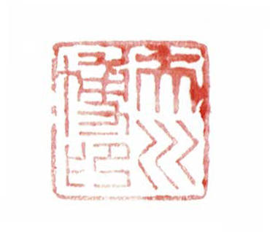

Slide 2

2024.6 Thailand

Slide 3

2025.6 Thailand

Slide 4

2024.7 Malaysia

Slide 5

2025.9 Vietnam

Slide 6
CERTIFICATE OF PATENT
PATENT NUMBER: 7542838
TITLE OF THE INVENTION: Therapeutic and prophylactic agent for lowering atrial natriuretic peptide, and manufacturing method thereof
PATENTEE: Scarecrow Inc. , 11-8 Shinsen-cho, Shibuya-ku, Tokyo
INVENTOR: Hiroshi Ōkawa APPLICATION NUMBER: 2024-021170
FILING DATE: February 15, 2024
REGISTRATION DATE: August 23, 2024
THIS IS TO CERTIFY THAT THE PATENT IS REGISTERED ON THE REGISTER OF THE JAPAN PATENT OFFICE.
August 23, 2024
COMMISSIONER, JAPAN PATENT OFFICE Yota Ono

